Slide 1
English I Literary Devices
(TAKE NOTES!!!)

Slide 2
AMBIGUITY

Slide 3
AMBIGUITY=
an element of uncertainty in a text, in which something can be interpreted in a number of different ways.

Slide 4
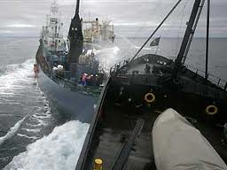
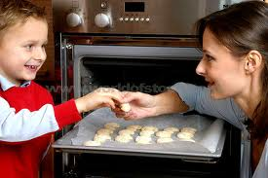
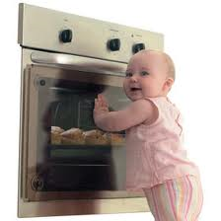
“Include your Children when Baking Cookies”
“Two Soviet Ships Collide, One Dies”

Slide 5
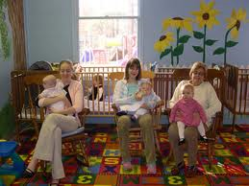
“For those of you who have children and don't know it, we have a nursery downstairs.”

Slide 6
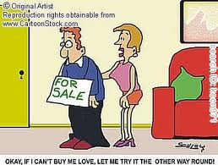
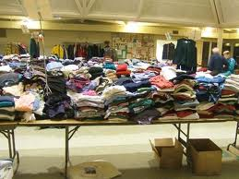
"Ladies, don't forget the rummage sale. It's a chance to get rid of those things not worth keeping around the house. Don't forget your husbands."

Slide 7
Allegory
a work in which the characters, images, and/or events act as symbols.
The symbolism in an allegory can be interpreted to have a deeper meaning.
An author may use allegory to illustrate a moral or spiritual truth, or political or historical situation.

Slide 11
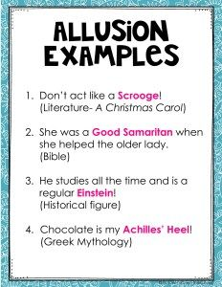
Allusion
brief and indirect reference to a person, place, thing or idea of historical, cultural, literary or political significance.

Slide 12
Anecdote
a short, personal account of an incident in someone’s life (usually intended to entertain or make a point).

Slide 13
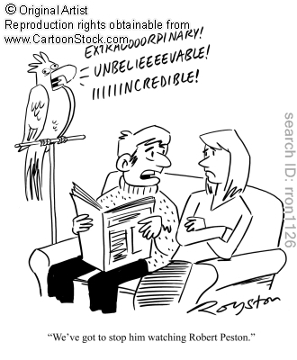
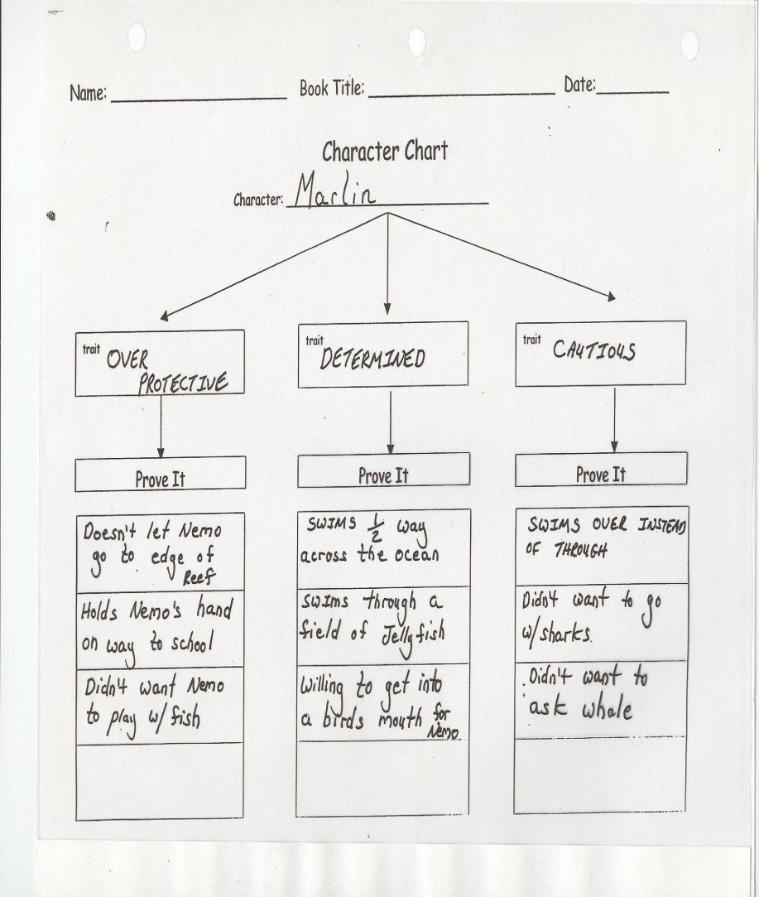
Characterization:
a description of qualities or peculiarities

Slide 14
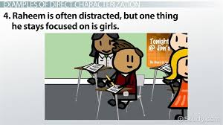
Direct Characterization
character is described by the author/narrator/ other characters.
(think adjectives)
C

Slide 15
Indirect Characterization
a character's traits are revealed by action and speech (think verbs/actions)

Slide 16
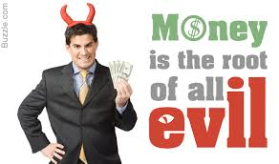
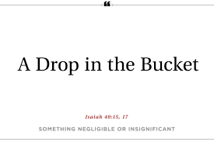
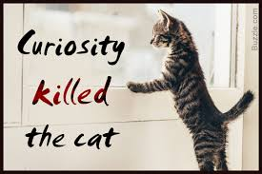
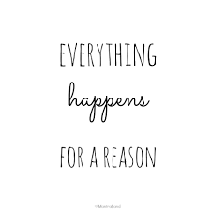
Cliché
an expression that has been overused to the extent that it loses its original meaning or novelty.

Slide 17
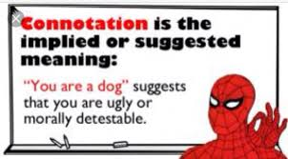
Connotation
an idea or feeling that a word invokes in addition to its literal or primary meaning.
Snake: evil, sneaky, deceitful, or treacherous.

Slide 18
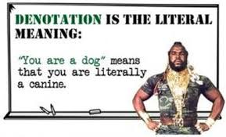
Denotation
literal or dictionary meaning of a word.
Snake: a long limbless reptile that has no eyelids, a short tail, and jaws that are capable of considerable extension.

Slide 19
Diction
word choice
In literature, writers choose words to create and convey a typical mood, tone, and atmosphere to their readers.

Slide 20
Types of Diction:

Slide 21
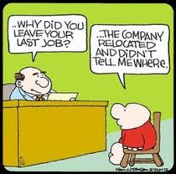
Euphemism
refers to polite, indirect expressions that replace words and phrases considered harsh and impolite or unpleasant.
Examples:
“let go” instead of “fired”
“passed away” instead of “died”

Slide 22
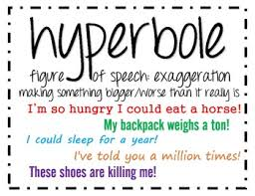
Hyperbole

Slide 23
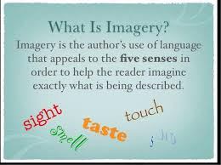
Imagery

Slide 24
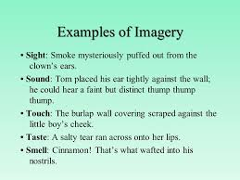
Imagery cont...

Slide 25
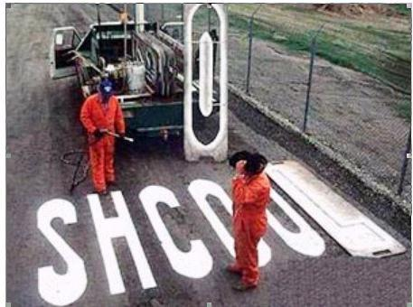
Irony:
Describes the difference between what we expect
versus
what actually happens.

Slide 26
Three types:
1. Situational Irony
2. Dramatic Irony
3. Verbal Irony

Slide 27
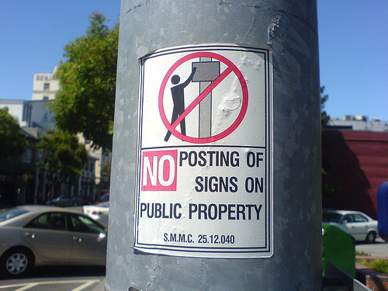
Situational Irony:
A contradiction between what we expect to happen and what really does take place.

Slide 28
Situational Irony:

Slide 29
Situational Irony cont...
A marriage counselor filed for divorce
A teacher failed a test
An anti-technology website
A fire station burns down

Slide 30
Dramatic Irony:
Occurs when the audience or the reader knows something important that a character in a play or story does not know.

Slide 31
Dramatic Irony cont….
In Star Wars, the audience know that Darth Vader is Luke’s father, but Luke does not know until Episode V.
In horror movies, the audience is aware that there is a killer in the house, but the character does not and they proceed to enter.
In Toy Story, human characters are not aware that the toys speak and move while the audience is aware.

Slide 32
Verbal Irony:
A writer/speaker says one thing but really means something completely different.
Example:
If you call a clumsy basketball player the new Michael Jordan, you are using verbal irony.

Slide 33
Verbal Irony cont...
Other examples:
A man looked out of the window to see the storm intensify. He turned to his friend and said “wonderful weather we’re having!”
Exclaiming “oh great” after failing an exam
As pleasant as a tooth canal (also a simile)

Slide 34
Other types of irony:

Slide 35
Contradiction: a proposition, statement, or phrase that asserts or implies both the truth and falsity of something
Examples:
“The restaurant opens at five o'clock and it serves dinner between four and nine.”
Contradictory Quotes:
A silent man is a wise one / A man without words is a man without thoughts.
Actions speak louder than words
The pen is mightier than the sword.

Slide 36
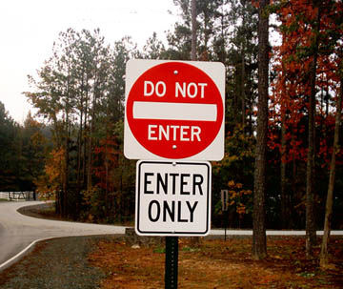
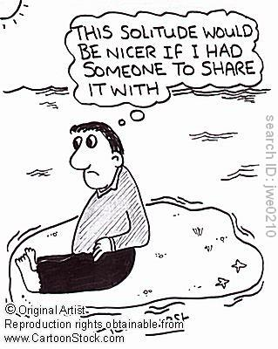
Contradictions Continued:
Examples:
Clothes make the man / Don't judge a book by its cover
Absence makes the heart grow fonder / Out of sight, out of mind.

Slide 37
Satire
the use of humor, irony, exaggeration, or ridicule to expose and criticize people's stupidity or vices, particularly in the context of contemporary politics and other topical issues.
“Weekend Update” from Saturday Night Live The Daily Show The movie Scary Movie

Slide 38
Satire continued...
#Hashtag
https://www.youtube.com/watch?v=57dzaMaouXA&list=PLbBDPi7RiSlwlJpt46Y05jCl5I7EMIZiq
Parkour
https://www.youtube.com/watch?v=0Kvw2BPKjz0&index=4&list=PLbBDPi7RiSlwlJpt46Y05jCl5I7EMIZiq&t=0s
Key & Peele Teaching Center
https://www.youtube.com/watch?v=dkHqPFbxmOU
Teenage Affluenza
https://www.youtube.com/watch?v=KFZz6ICzpjI

Slide 39
Metaphor
comparison between two things that are unrelated, but which share some common characteristics.
Implicit comparison uses “is” or “are” to make comparison.

Slide 41
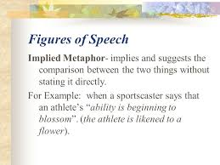
Implied Metaphor

Slide 42
Mood
evokes certain feelings/creates an atmosphere

Slide 43
Rhetorical Triangle

Slide 44
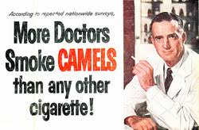
Ethos
appeal used to convince an audience of a reliable character or credibility of the speaker/writer.

Slide 45
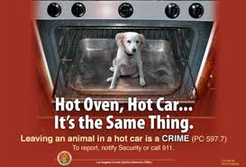
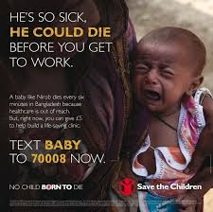
Pathos
appeal used to create a persuasive argument by evoking an emotional response in the audience/reader.

Slide 46
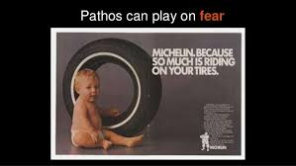
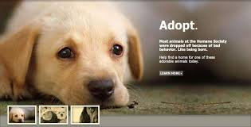
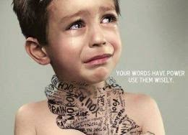
Pathos continued...

Slide 47
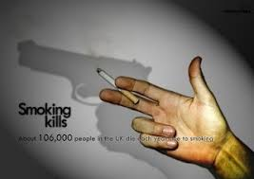
Logos
appeal used to persuade an audience by logical thought, fact, and rationality (common sense).

Slide 48
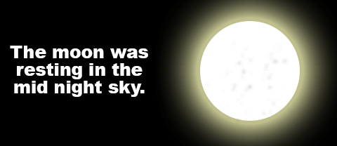
Personification
a thing, idea or animal is given human attributes.
Examples:
The wind whispered through dry grass.
The flowers danced in the gentle breeze.
The fire swallowed the entire forest.

Slide 49
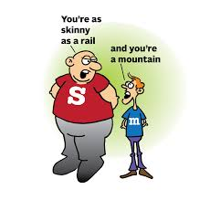
Simile
Compares two different things
using the words “like” or “as.”
At exam time, the high school student was as busy as a bee.
When the examination finished, the candidate felt as light as a feather.
When the teacher entered the class, the 6th-grade students were fighting like cats and dogs.

Slide 50
Symbolism
the use of symbols to signify ideas and qualities by giving them symbolic meanings that are different from their literal sense.

Slide 51
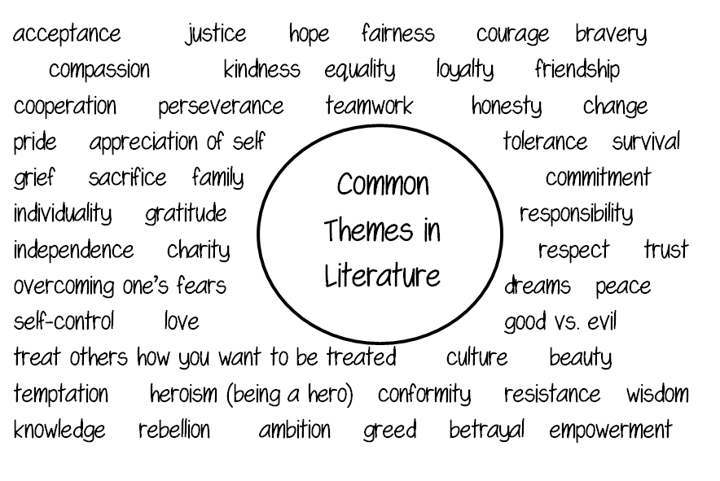
THEME
The central idea/moral promoted in the story
the insight the story wishes to convey
*
51

Slide 52
TONE
Attitude the writer takes toward a subject, a character, or the audience.
To illustrate the difference, two different novelists might write stories about capitalism.

Slide 53
Tone continued…
Author #1:
creates a tale in which an impoverished but hard-working young man pulls himself out of the slums when he applies himself to his education, and he becomes a wealthy, contented middle-class citizen who leaves his past behind him, never looking back at that awful human cesspool from which he rose.

Slide 54
Tone Continued…
Author #2:
Creates a tale in which a dirty street-rat skulks his way out of the slums by abandoning his family and going off to college, and he greedily hoards his money in a gated community and ignores the suffering of his former "equals," whom he leaves behind in his selfish desire to get ahead.

Slide 55
KEEP IN MIND:
Both author #1 and author #2 basically present the same plotline.
First author's writing creates a tale of optimism and hope
Second author shapes the same tale into a story of bitterness and cynicism.

Slide 56
Tone Continued…
The difference is in their respective tones--the way they convey their attitudes about particular characters and subject-matter.

Slide 57
Teaching tone with movies
Frozen:
https://www.youtube.com/watch?v=9eD2UpdhbwA&list=PLBjIqRvyNjs8scZZ1ukAzlyH4mRveAYS-
Original: https://www.youtube.com/watch?v=TbQm5doF_Uc
Mrs. Doubtfire:
https://www.youtube.com/watch?v=U71P5FKFqfg&list=PLBjIqRvyNjs8scZZ1ukAzlyH4mRveAYS-&index=6
Original: https://www.youtube.com/watch?v=RzZsdL-EGwg
Harry Potter and Half Blood Prince:
https://www.youtube.com/watch?v=c_ubmjE21SY&list=PLBjIqRvyNjs8scZZ1ukAzlyH4mRveAYS-&index=13
Original: https://www.youtube.com/watch?v=jpCPvHJ6p90&index=14&list=PLBjIqRvyNjs8scZZ1ukAzlyH4mRveAYS-
Mary Poppins
https://www.youtube.com/watch?v=2T5_0AGdFic&index=2&list=PLwRF5bRIjrMxOuA_2Wp2lmObjQot3XHfo
Original: https://www.youtube.com/watch?v=nOfH7uEojKk

Slide 58
Continued…
Forrest Gump:
https://www.youtube.com/watch?v=1GiYx1r4200&list=PLwRF5bRIjrMxOuA_2Wp2lmObjQot3XHfo&index=7
The Shining:
https://www.youtube.com/watch?v=KmkVWuP_sO0&index=11&list=PLwRF5bRIjrMxOuA_2Wp2lmObjQot3XHfo
Home Alone:
https://www.youtube.com/watch?v=kckadRU3q_g&index=13&list=PLwRF5bRIjrMxOuA_2Wp2lmObjQot3XHfo
Titanic:
https://www.youtube.com/watch?v=oxwTS2hinBA&index=17&list=PLwRF5bRIjrMxOuA_2Wp2lmObjQot3XHfo

Slide 59
The Importance of Correct Punctuation
Dear John: I want a man who knows what love is all about. You are generous, kind, thoughtful. People who are not like you admit to being useless and inferior. You have ruined me for other men. I yearn for you. I have no feelings whatsoever when we're apart. I can be forever happy--will you let me be yours? Gloria

Slide 60
Dear John: I want a man who knows what love is. All about you are generous, kind, thoughtful people, who are not like you. Admit to being useless and inferior. You have ruined me. For other men, I yearn. For you, I have no feelings whatsoever. When we're apart, I can be forever happy. Will you let me be? Yours, Gloria

